Slide 1
QG Project Launch
TST-DENC-UITOOLCHAIN project
Toshiba Software Development Vietnam Co., Ltd
Scope of Disclosure | TSDV
Period of confidentiality | Until being replaced
Head of Information Owner | Head of TSDV
Handling restriction | No re-disclosure

Slide 2
Contents
TST-DENC-UITOOLCHAIN Overview
Workflow
Project Organization
Project Master schedule
Project Objective
Quality activity
Project Risk
CAR Report
Current status
QG checklist
Judgment and Discussion

Slide 3
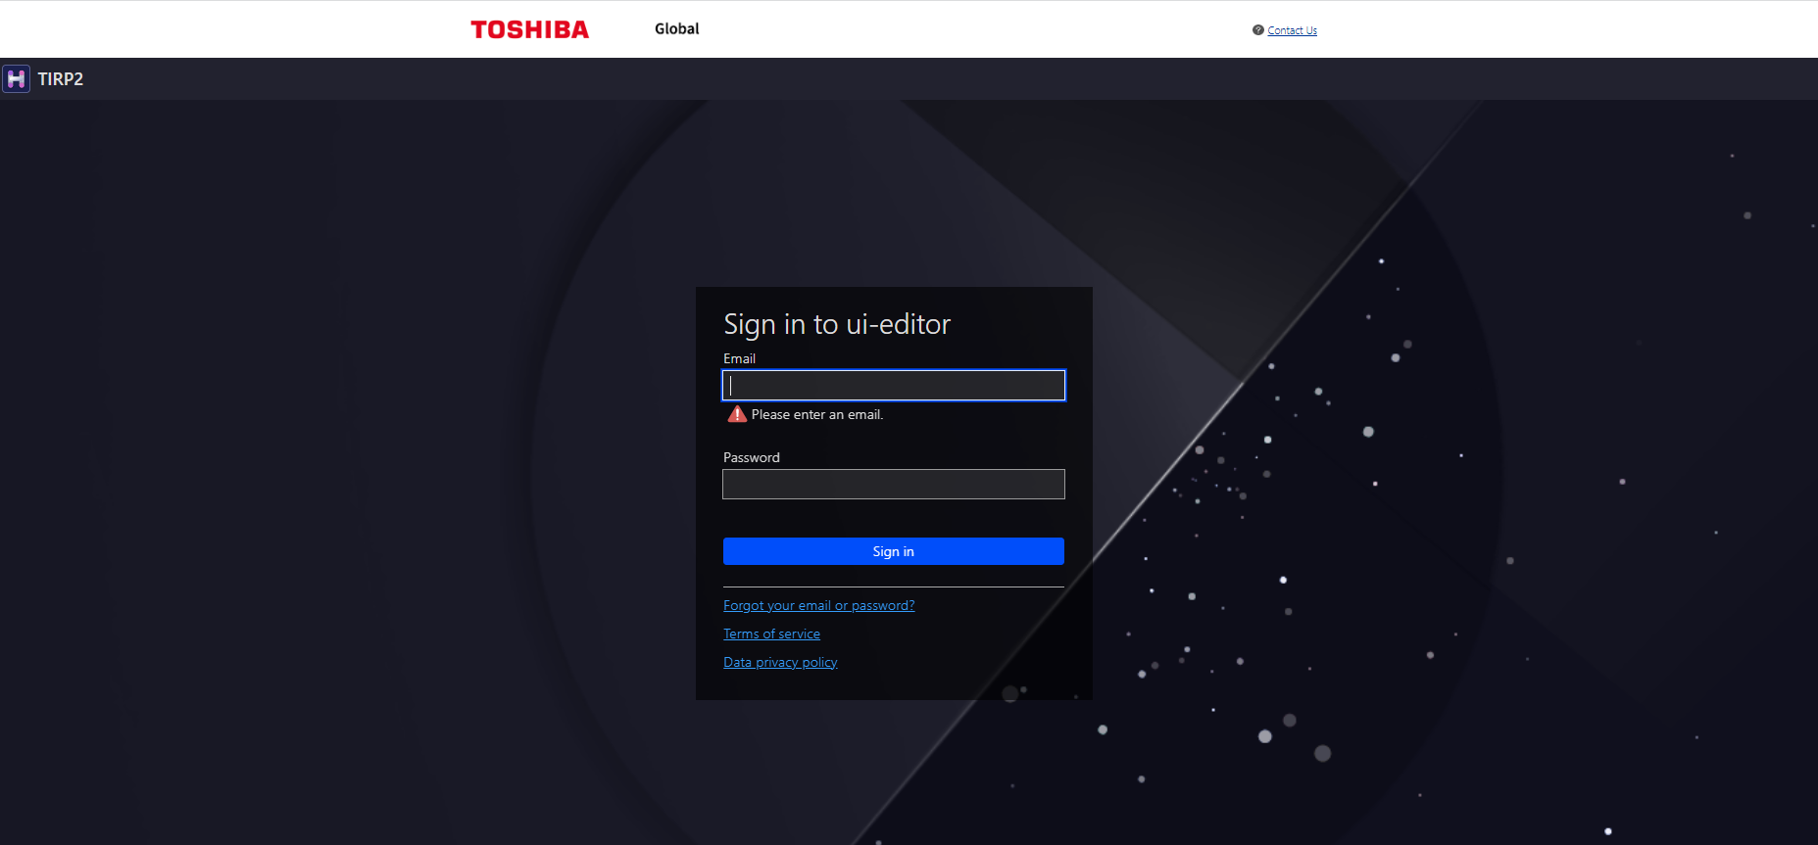
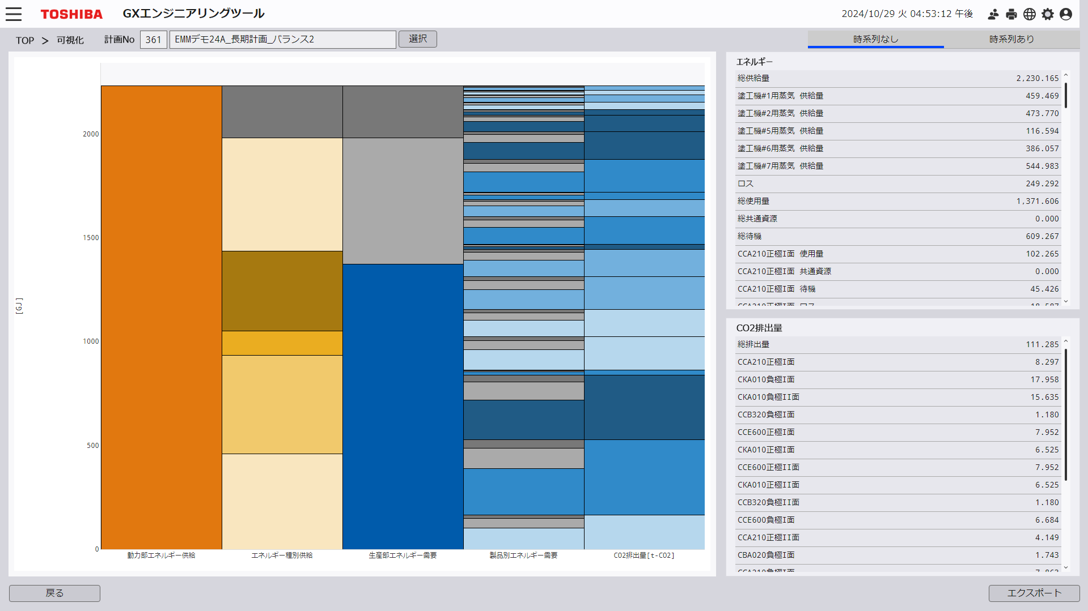
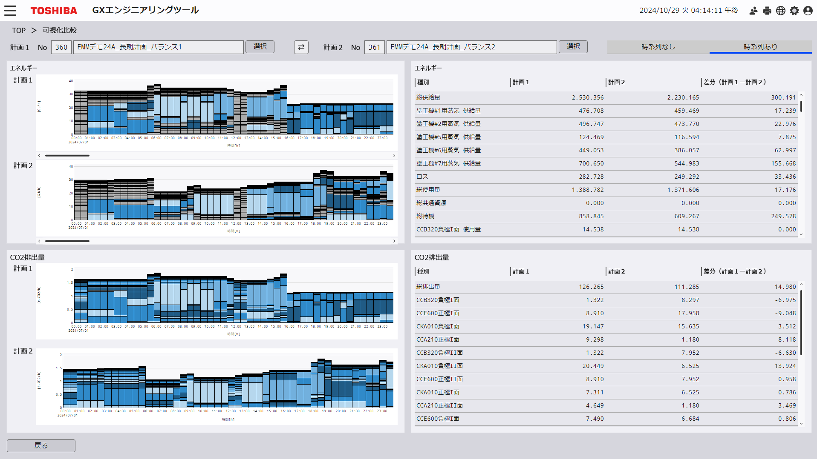
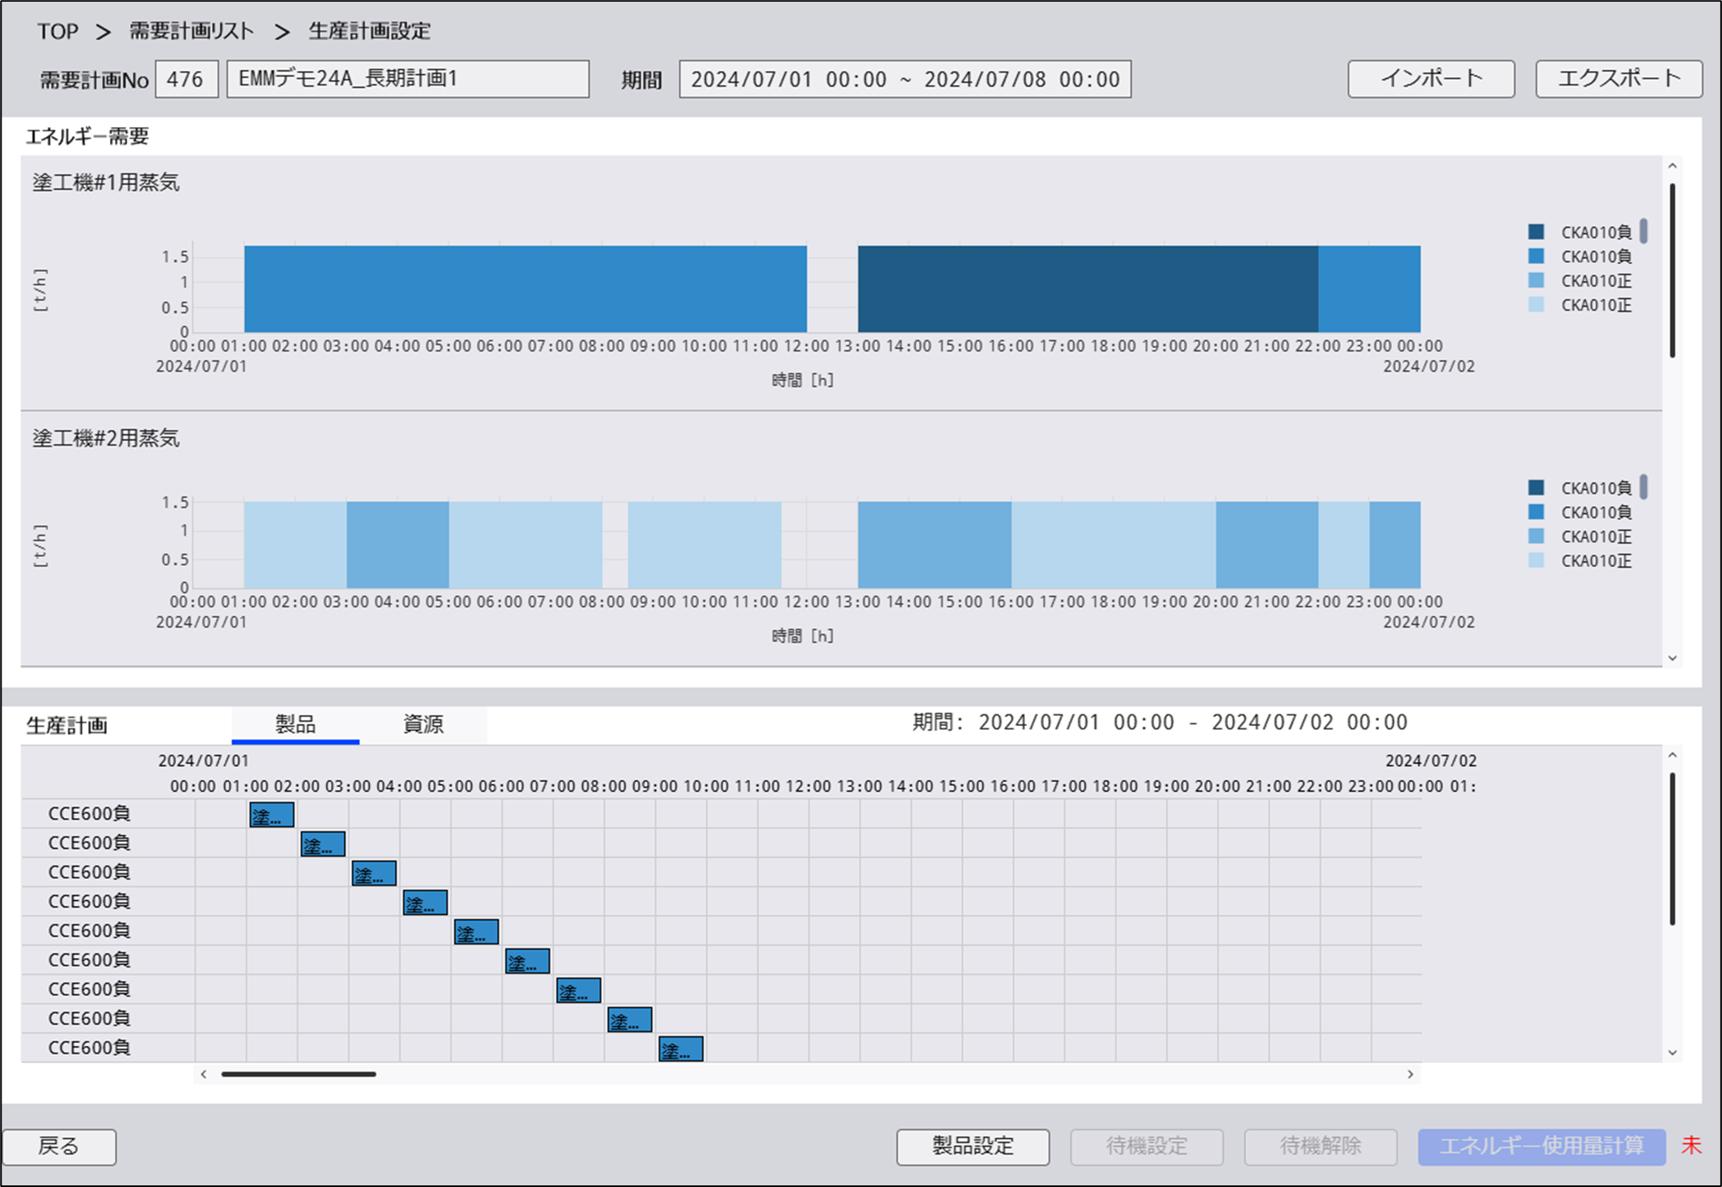
1. TST-DENC-UITOOLCHAIN Overview
TST customer use UI-Toolchain service in “TOSHIBA SPINEX for Energy” platform to develop GX engineering tool.
PJ Type: Enhancement (Update screens that created before and create new screen if need)

Slide 4
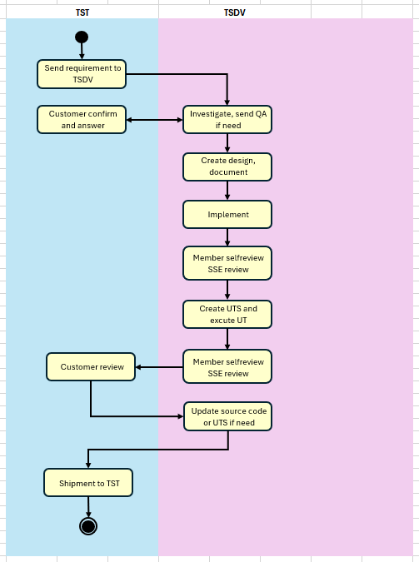
2. Workflow

Slide 5
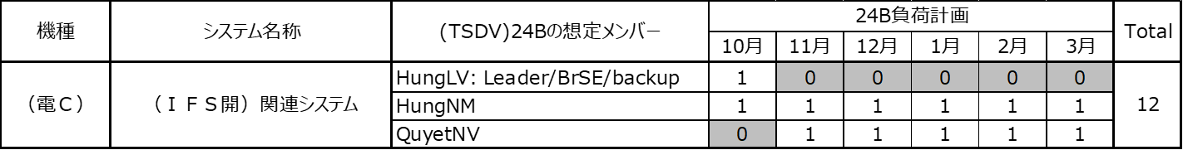
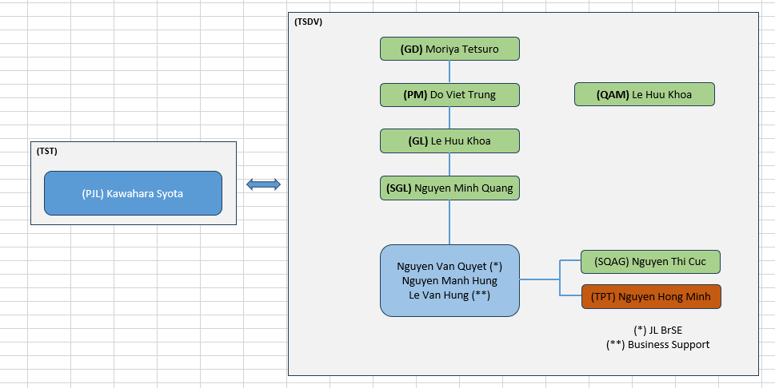

3. Project Organization
Human Resource
Project Organization

Slide 6
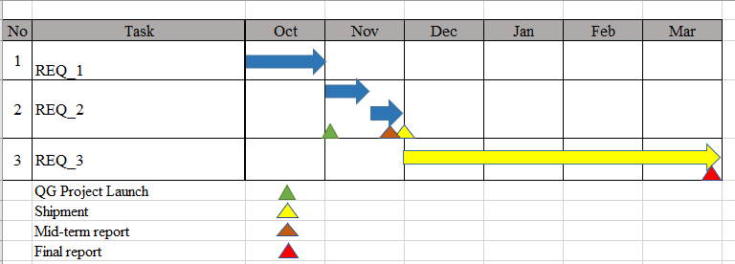
4. Project Master schedule
Refer to:
http://redmine.tsdv.com.vn/project_plans/24b-g2-tstdencuitoolchain
+ PJ team received 2 REQs from customer
+ Plan for 1st shipment is end of Nov, the QG for mid-term report will be hold before shipment.
+ Other REQs will be sent by customer later
+ Beside that, PJ team have new plan for other job that called DLR
Developed in UI-ToolChain platform
PJ team are checking and waiting detail request from customer
Customer are SY7 but they are belong to other department
-> PJ Team will report detail plan when clear REQ

Slide 7
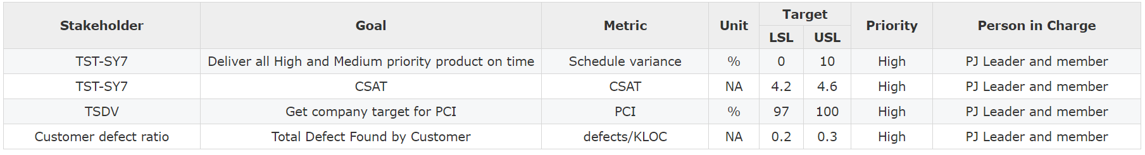
5. Project Objective
With all project objectives

Slide 8
6. Quality activity
Internal Quality activity :
Using checklist to review source and UT (Checklist is updated by PJ team for 24A)
SSE will join review as a first round
Leader will review product as a second round
Run static checking tool (EsLint)
External Quality activity :
Demo and share solution to customer timely (2 times/week and directly on demand)

Slide 9
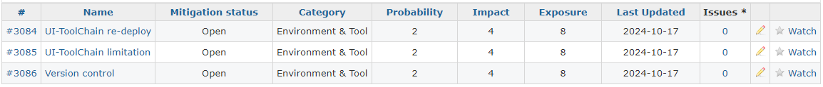
7. Project Risk
Project Risk http://redmine.tsdv.com.vn/project_risks/24b-g2-tstdencuitoolchain/index

Slide 10
8. CAR Report

Slide 11
9. Current project status
Refer: http://svn.tsdv.com.vn/svn/24B-G2-TSTDENCUITOOLCHAIN/trunk/management/planing/小工程_UI-Toolchain-24B.xls
Current status: On schedule
PJ team are creating environment to develop for 24B
Fixed remain bug from 24A

Slide 12
10. QG checklist
Refer to checklist:
http://redmine.tsdv.com.vn/issues/185351/quality_gate_issue_checklists/4274

Slide 13
11. Judgment and Discussion
This slide is used for all stakeholders if any question or discussion
Rank Confirmation:
Higher manager will conclude the result and action items (if any)
Result:
Action Item:
1.
2.

